Slide 1
Stereoscopic vision
(3d –Reconstruction)
Name-Shreyansh jain(17bce1018)

Slide 2
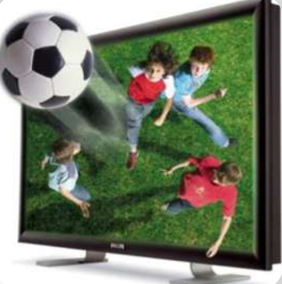
Why Do We Call It Stereoscopic Vision?
Derived from the Greek word “Stereos” meaning Solid and “Scope” meaning Look/View, so stereoscopy means solid view of an object i.e. 3D view.
In general life, it is known as 3D Imaging.
It is the technique used to create the illusion of depth in an offset image by presenting two slightly different perspectives of the same object to the eyes of the viewer.

Slide 3
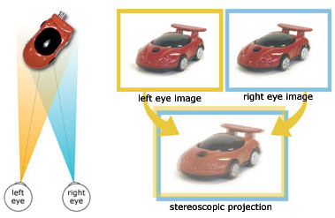
How Does Stereoscopic (3D) Vision Work?
3D vision is the direct effect of our brains merging the images from both of our eyes together.
Each of our eyes creates a single two-dimensional image, but the brain is able to interpret depth when it merges both two-dimensional images and understands the difference between them. We call this ability stereoscopic vision.

Slide 4
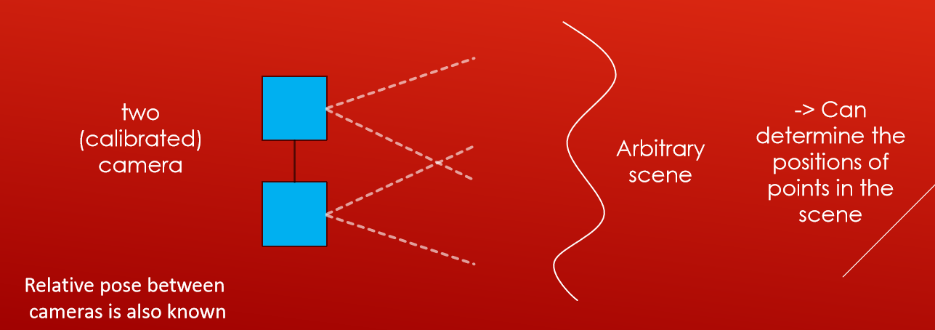
Inferring 3D From 2D
Stereo vision: if we have two cameras and we know the relative pose between them we can find 3D information from an arbitrary seen we don’t have to know model in the seen and we can determine the position in that scene from those two cameras

Slide 5
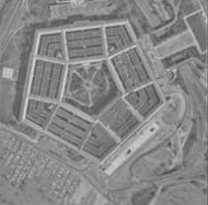
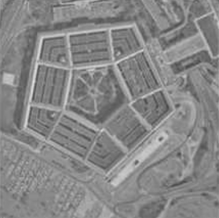
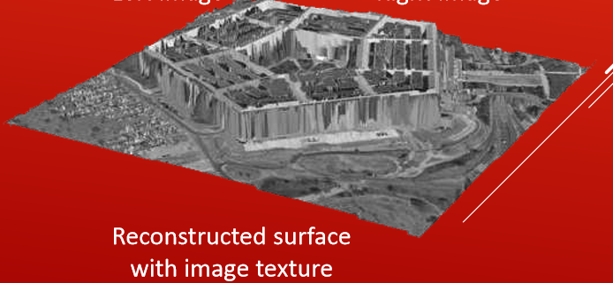
A way of getting depth (3-D) information about a scene from two (or more) 2-D images
- Used by humans and animals, now computers
Left image
Right image

Slide 6
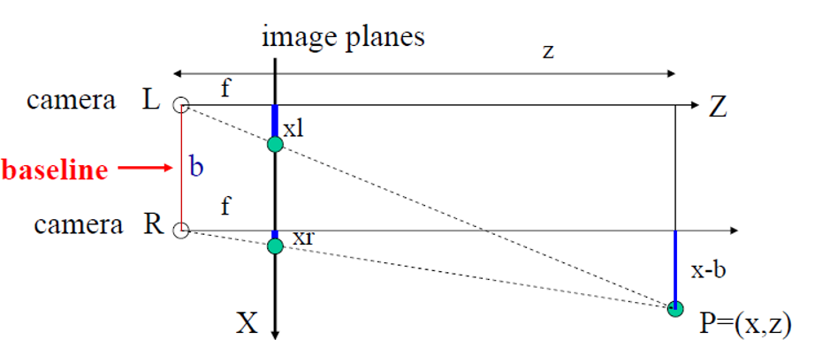
Simple Model: Optic axes of 2 cameras are parallel
𝑧/𝑓=𝑥/𝑥𝑙 , 𝑧/𝑓= 𝑥−𝑏/𝑥𝑟 , 𝑧/𝑓= 𝑦/𝑦𝑙= 𝑦/𝑦𝑟

Slide 7
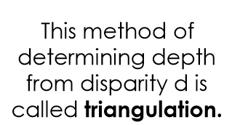
3D from Stereo Images: Triangulation
For stereo cameras with parallel optical axes, focal length f,
baseline b, corresponding image points (xl,yl) and (xr,yr), the location of the 3D point can be derived from previous slide’s equations:
Depth z = 𝑓 *𝑏/𝑥𝐿−𝑥𝑅 = 𝑓/𝑏

Slide 8
TECHNIQUES
There are two techniques of producing stereoscopic images:
1. Film Photography
2. Digital Photography

Slide 9
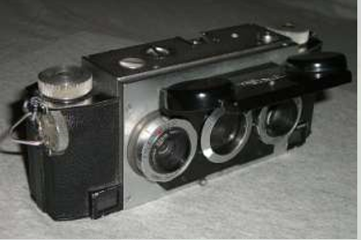
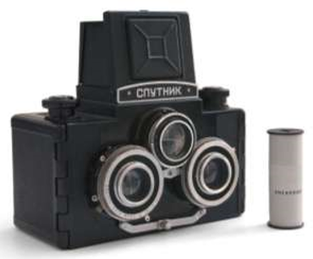
FILM PHOTOGRAPHY
Aim is to take two photographs from different horizontal positions to get a true stereoscopic image pair.
This can be done with two separate side-by-side cameras. Or with the help of stereo cameras incorporating two or more side-by-side lenses.
At least 3 lenses are required in a stereo camera

Slide 10
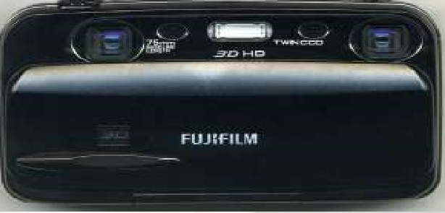
DIGITAL PHOTOGRAPHY
There are Stereo lenses which turn an ordinary film camera into a stereo camera by using a special double lens to take two images and direct them through a single lens to capture them side by side.
These are also available for digital SLR cameras.
In 2009 digital Stereo cameras such as the Fuji W1 began appearing in the consumer market.

Slide 11
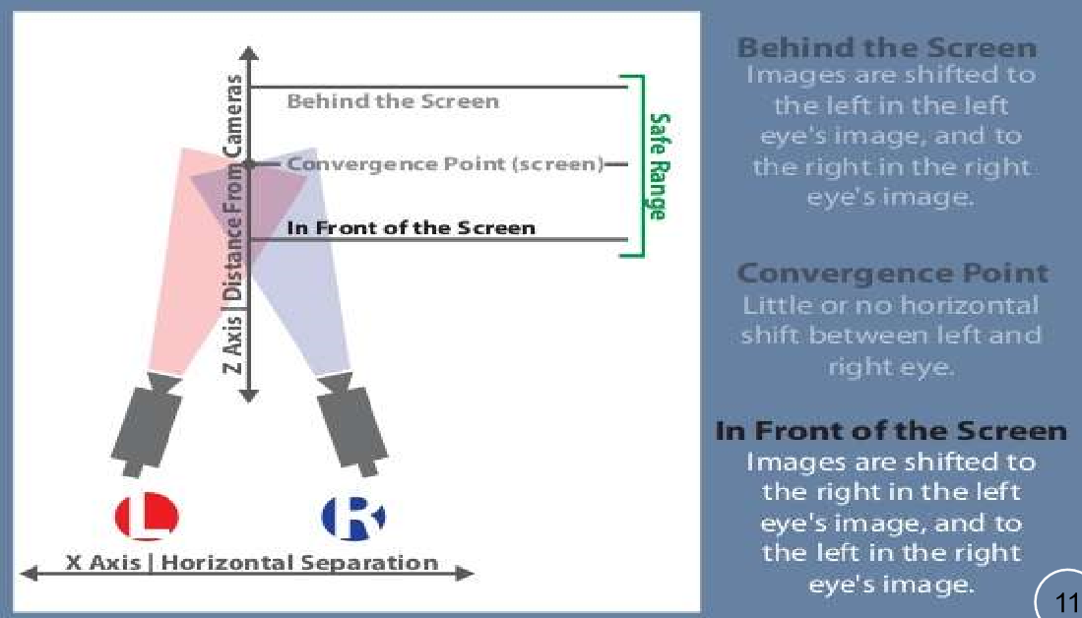
WORKING

Slide 12
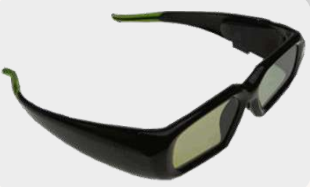

STEREOSCOPIC VIEWERS
There are two categories of stereoscopic viewer technology,
1. Active
2. Passive
Active viewers have electronics which interact with a display.
Passive viewers filter constant streams of binocular input to the ,,,,appropriate eye.

Slide 13
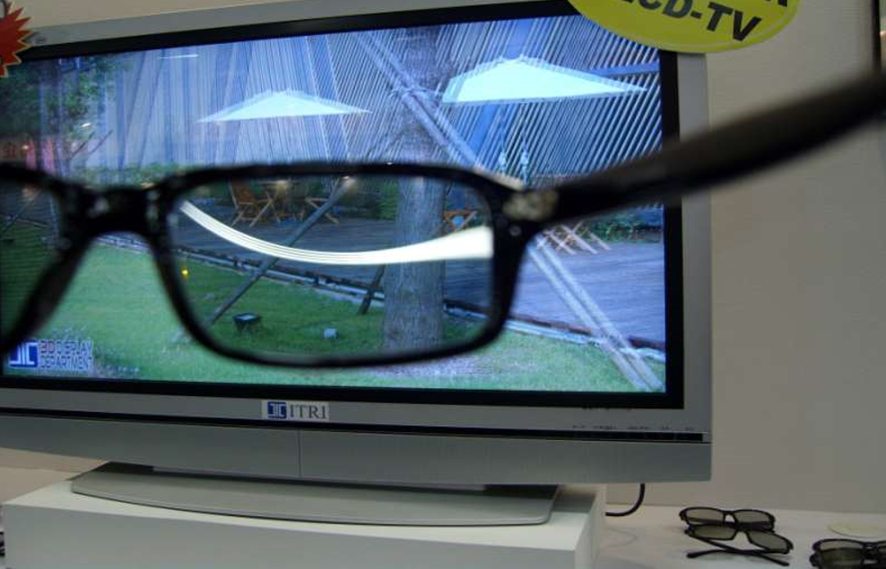
3D VIEWERS
View With & Without 3D Viewers

Slide 14
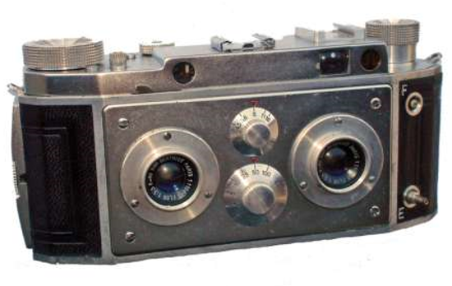
TYPES OF STEREO CAMERAS
Types of Stereo Cameras:
1. Kodak Stereo Camera
2. Loreo
3. Nimslo 3D
4. Fujifilm FinePix Real 3D
5. Samsung NX-300

Slide 15
APPLICATIONS
It is extensively used for amusement which includes 3D films.
Space Exploration - Various spaceships are equipped with unique cameras that allow researchers to view stereoscopic images of the surface of planets.
Clinical Uses – Stereoscopy is frequently used by vision therapists in the treatment of many binocular vision and disorders.
This technique is also used in holography.

Slide 16
PROS & CONS OF STEREOSCOPIC IMAGING
By producing a concise visual summary from cross-sectional exams, 3D imaging can,
1. Create studies that are faster and easier to read.
2. Facilitate diagnoses, treatment and surgical planning.
3. Increase clinical productivity.
It gives a better view of any object so its study becomes easy and productive.
Stereoscopic imaging technique requires very high cost.
It is not available everywhere.
This technique uses eye glasses which becomes uncomfortable for the persons wearing spectacles.

Slide 17
THANK YOU

